Slide 1



COMMUNITY
MARKET PLACE
Guide Name
Mr.M. Purnachandrarao
version
valid until
prepared by
S.Bhargav(23211A67A7)
T.Nikitha(23211A67B6)
S.Vinod(23211A67A6)
0.4.0
01/05/2025
2025-Minor-B-4

Slide 2
contents
1
Existing System
7
Timeline
2
Problem and Solution
8
Conclusion
3
Goals and Benefits
4
Methodology
5
Technology Stack
6
Deliverables

Slide 3
Existing Problem
Existing Problem Statement
The current grocery market is inefficient for individuals who face high costs due to small-quantity purchases, while vendors struggle with unsold inventory and distribution inefficiencies. There is no dedicated platform that enables communities to collectively order groceries in bulk, securing wholesale prices while optimizing vendor sales.

Slide 4


Problem and Solution
The Problem
Elaborate
on the problem, its context, and your proposed solution.
High Grocery Costs for Individuals
Lack of a Group Buying Platform
Vendor Inefficiencies
Logistical Challenges
Trust & Adoption Issues
The Solution
Bulk Ordering Model
Vendor Onboarding and Verification
Logistics and Delivery Solutions
Technology Platform Development
Community Engagement and Marketing.

Slide 5

Goals and Benefits
goals
Reduce Grocery Costs
Optimize Vendor Sales
Enhance Community Engagement
Streamline Logistics
benefits
Cost Savings
Increased Sales
Community Building
Environmental Impact
Convenience

Slide 6

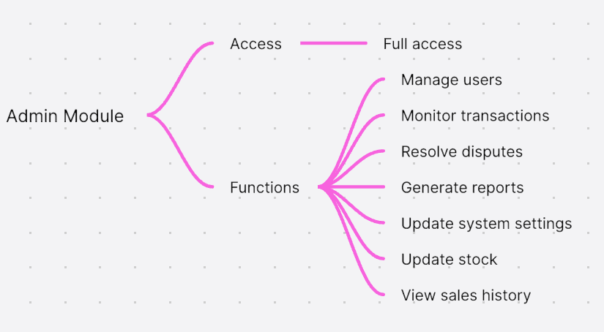
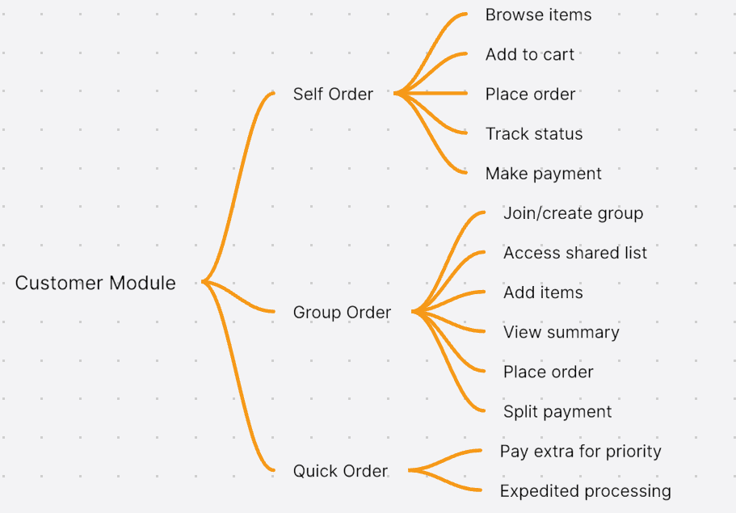
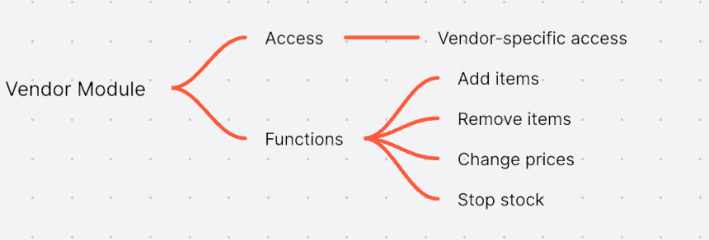
Methodology

Slide 7
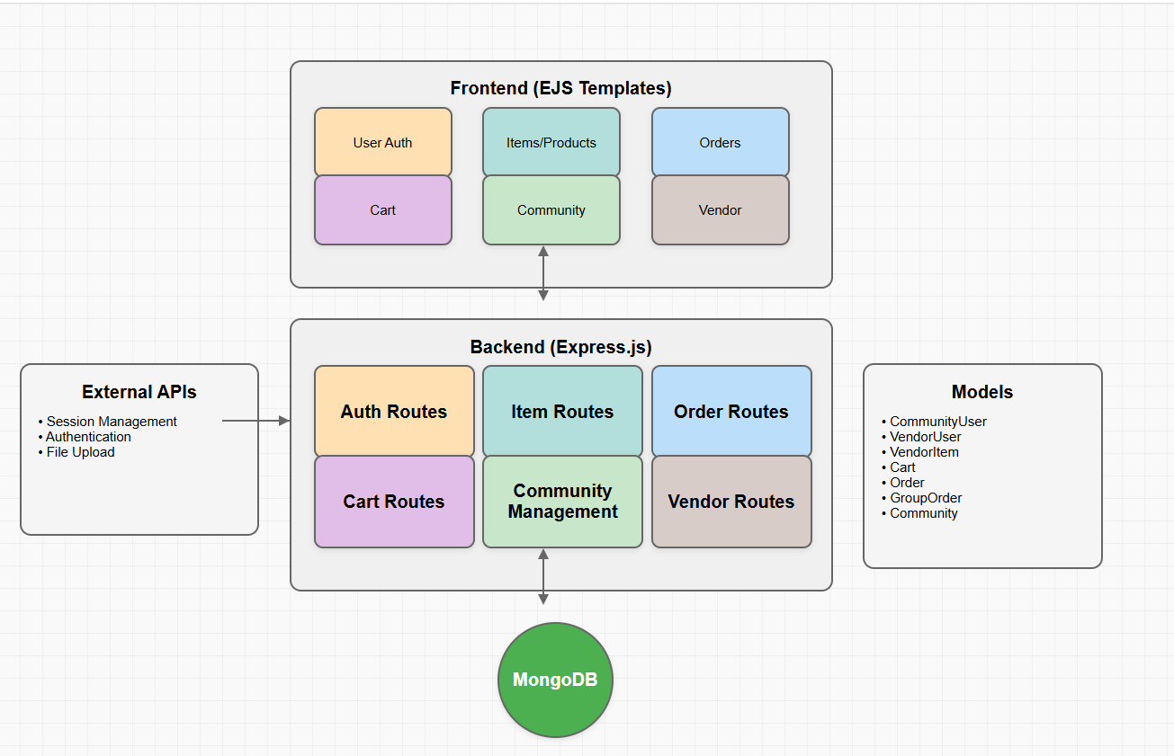
System Architecture
Architecture

Slide 8
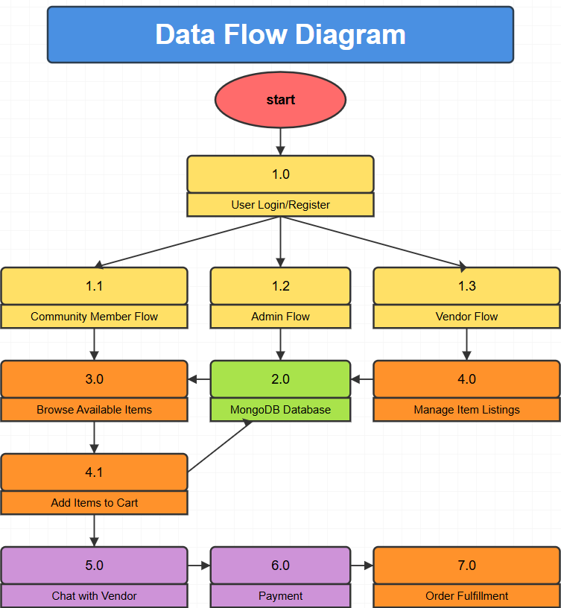
DFD

Slide 9
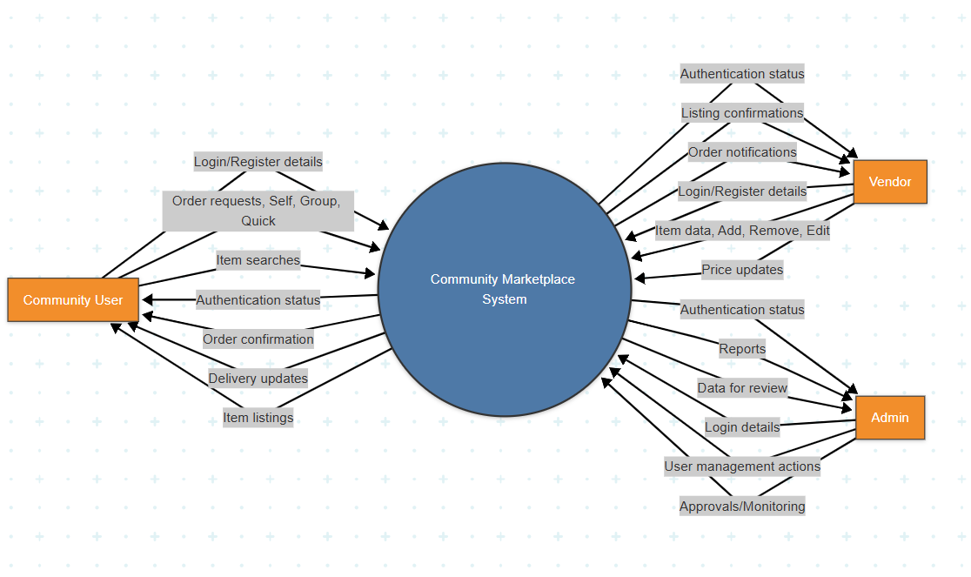
DFD

Slide 10

Deployment and Monitoring
Deployment Environment
Front-End & Back-End: Render
Database: MongoDB Atlas
Monitoring
Website Performance:
Google Analytics: Monitor traffic and user behavior.
PageSpeed Insights: Check loading speed and get optimization tips.
Addressing Performance Degradation:
Caching
Database Optimization

Slide 11

Technology Stack
RESOURCE ITEM(Hardware/Software) | PROJECT PHASE / MILESTONE | ESTIMATED COST
HTML/CSS/JAVASCRIPT/EJS(Software) | Frontend Development | Free (Open-source)
Express (Software) | Framework | Free (Open-source)
Node.js (Software) | BackendDevelopment | Free (Open-source)
MongoDb (Software) | Database Design & Implementation | Free (Open-source)
Git/GitHub (Software) | Version Control & Collaboration | Free (Open-source)
Cloud Hosting Service (e.g., AWS,Vercel) | Deployment & Hosting | Free(Open-source)
TOTAL COSTS :
0
PROJECT PROPOSAL

Slide 12
timeline
TASKS | January | February | March | April
Task 1 : Initial Setup and Configuration
Task 2 : Core Functionality Implementation
Task 3 : UI/UX Design
Task 4 : Backend Development
Task 5 : Frontend Development
Task 6 :API Integration
Task 7 :Testing and Debugging
Task 8 : Deployment
Task 9: Documentation and Feedback
31/01 – 08/02
09/02-17/02
18/02 – 26/02
27/02 – 14/03
15/03 – 22/03
23/03 – 07/04
08/04 – 15/04
15/04 – 23/04
23/04 – 04/05

Slide 13
Conclusion
Addressed Key Problems: Proposed solutions effectively tackle high grocery costs, vendor inefficiencies, and lack of a group buying platform.
Achieved Goals: Successfully outlined a bulk ordering model, vendor onboarding, logistics solutions, and community engagement strategies.
Benefits Realized: Demonstrated potential for significant cost savings, increased sales, enhanced community engagement, and streamlined logistics.
Future Work: Plan for pilot testing, scalability, continuous improvement, and strategic partnerships to expand the platform.
Call to Action: Encourage stakeholders to join the initiative to create a more efficient and community-driven grocery marketplace.

